Slide 2
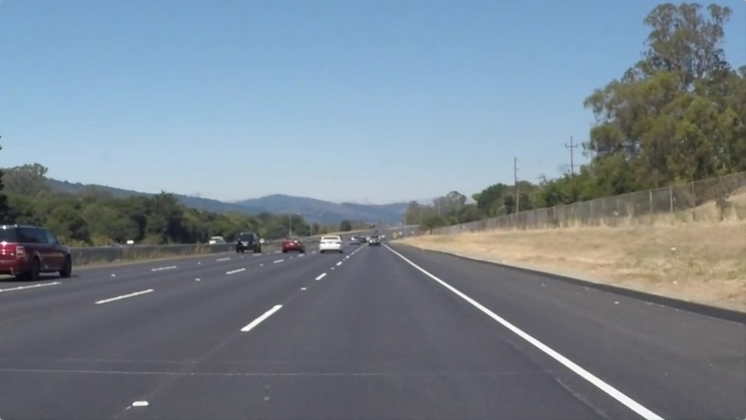
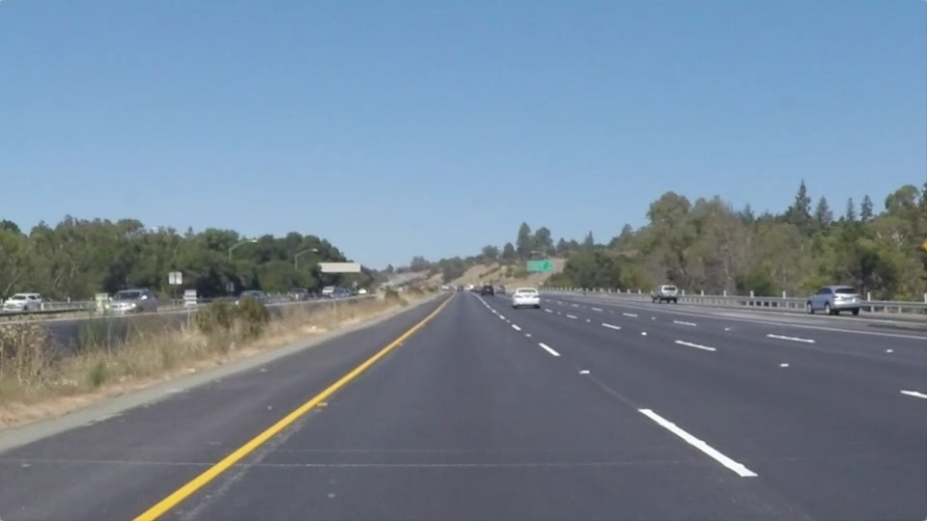
Practice Session 2
In this practice session we will define a special computer vision pipeline
The goal of the pipeline is to detect lane lines in images and video
We are using different images to check if we worked correctly
We are applying our CV Knowhow from the lecture

Slide 3
0. Define the pipeline
First of all we have to define the pipeline for processing the image
We are splitting the code in two parts
A function which is called “process_image”
A main software part which is loading the image
In addition, for a better overview we are moving all functions for processing the image to a library called “functions.py”

Slide 4
1. Load an image
In the second step we are loading the images
We define one folder called „test_images“
In this folder we can integrate as much pictures as we want
With we can list all images in this folder
After that we are calling each image in an for loop and we are processing each image in an foor-loop
images = os.listdir("test_images/")

Slide 5
2. Apply Gaussian Blur
In the first steps of image processing, we have to
Get the scale of the image
Transfer image to greyscale
Apply Gaussin Blur to the image
The Guassian Blur function is applied with openCV
imshape = image.shape gray = functions.grayscale(image) blur_gray = functions.gaussian_blur(gray, 5)
return cv2.GaussianBlur(img, (kernel_size, kernel_size), 0)
Notes:
Why Greyscale ?
What does Kernel Size mean ?

Slide 6
3. Perform Canny Edge Detection
In the first steps of image processing, we have to apply
The canny edge detection algorithm
The Canny Edge Algorithm is applied with openCV
canny_blur = functions.canny(blur_gray, 100, 200)
return cv2.Canny(img, low_threshold, high_threshold)
Notes:
What is high and low Threshold?

Slide 7
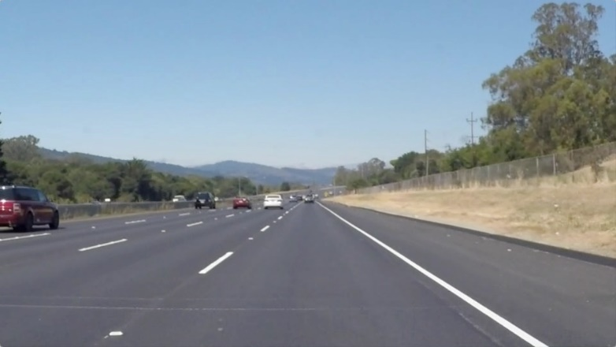
4. Define a region of interest
In the third step we have to find a region of interest to lower the computational load
What could be a good region of interest in this picture?

Slide 8
5. Retrieve Hough lines
In the last processing step we are applying the hough line detection to the image to find the points which are on one line
The Hough line algorithm needs a lot of input parameters
hough_picture = functions.hough_lines(region_masked, 2, np.pi / 180, 20, 50, 30)

Slide 9
6. Apply lane lines to the image
In the last step we are applying the lines to the image
We are combining the original image with the hough line image

Slide 10
7. Apply lane lines to vidoes
Now we can do the same not only with pictures

Slide 11
8. Conclusion

Slide 12
9. Improvements

